Slide 1
October 2023
The way forward for the usage of structured postal address in payments messages

Slide 2
Aligned decisions after Payments Standard Maintenance Group (27.06.2023) and HVPS+ Workshop (28.06.2023)

Slide 3
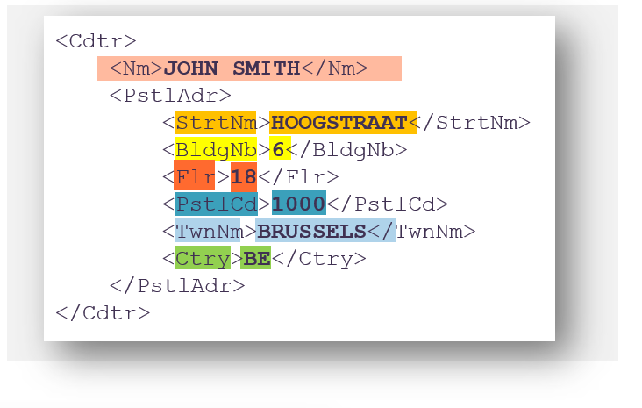
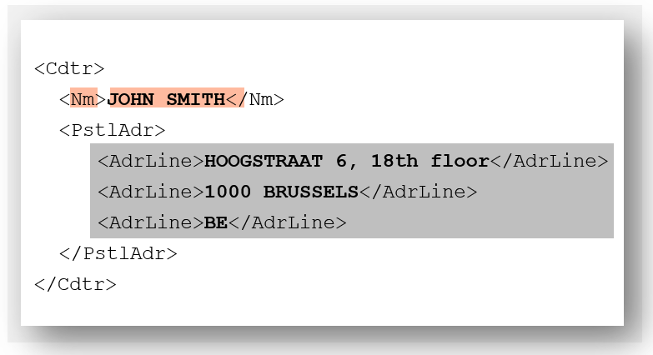
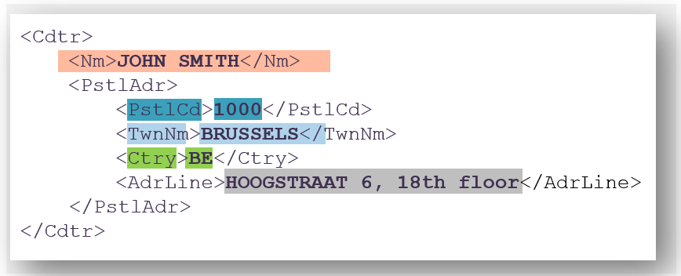
Postal Address options
Preferred
new
Fully structured
Unstructured
Hybrid
In scope of PMPG CR
All available address data is mapped into one of the 14 ISO 20022 fields
No co-mingling of data
No combination with “AdrLine” allowed
No combination with structured ISO 20022 address elements allowed
Difficulty to interpret data due to co-mingling of address elements
Combination of structured ISO 20022 address elements and up to 2 lines of 70 characters of unstructured “AdrLine” allowed
Elements available in structured format must be mapped into the respective structured element (minimum: TownName & Country)
Structured elements must not be repeated in the AdrLine element(s)
Network validation rules
Textual rule

Slide 4
Timeline
Proposed by the Payments Standards Working Group on 27 June 2023
End of MT/MX coexistence
1 Year after coexistence MT / MX
Today
November 2025
November 2026
Postal Address option
2023
2024
2025
2026
2027+
Preferred
Fully structured
Fully structured Postal Address can be used already today (preferred format)
End of «Unstructured»
Unstructured
Migration to fully structured or hybrid Postal Address
Unstructured addresses will be rejected by Swift & local RTGS systems
new
Go-live «Hybrid»
Hybrid
Approval of change request
Preparation for hybrid Postal Address
Hybrid Postal Address can be used
2023
2024
2025
2026
2027+
MT / MX coexistence for payments messages
Grace period for unstructured addresses
Only fully structured or hybrid addresses allowed
No end-date for hybrid address option
Go-live of hybrid option must happen at the same time in Swift MX (CBPR+) and local RTGS systems (HVPS+)
The decommissioning of unstructured addresses must happen at the same time in Swift MX (CBPR+) and local RTGS systems (HVPS+)
Proposed changes apply for all payments MX message types containing a Postal Address (pacs.008/009/004, pain.001 relay)
Proposed changes apply for all elements in these message types with Postal Address (debtor, creditor, ultimates* and agents*)
* Exception: for the elements ‘ultimate debtor’, ‘ultimate creditor’ & ‘initiating party’, the unstructured option won’t be allowed

Slide 5
Impacted CBPR+ & HVPS+ message types and ISO20022 elements
Impacted pacs message types:
Impacted pain & camt message types¹:
Message type | Description
pacs.008 | FI-to-FI Customer Credit Transfer
pacs.008 (stp) | FI-to-FI Customer Credit Transfer ‘STP’
pacs.009 (core) | Financial Institution Credit Transfer
pacs.009 (cov) | Cover Financial Institution Credit Transfer ‘Cover’
pacs.009 (adv) | Advice Financial Institution Credit Transfer ‘Advice’
pacs.002 | FI-to-FI Payment Status Report
pacs.003 | FI-to-FI Customer Direct Debit
pacs.004 | Payment Return
pacs.010 | Interbank Direct Debit
Message type | Description
pain.001 (relay) | Customer-to-Bank ‘Relay’ Credit Transfer
pain.002 | Customer Payment Status Report
pain.008 | Customer Direct Debit Initiation
camt.029 | Resolution of Investigation
camt.055 | Customer Payment Cancellation Request
camt.056 | FI-to-FI Payment Cancellation Request
camt.057 | Notification to Receive
camt.058 | Notification to Receive Cancellation Advice
camt.060 | Account Reporting Request
camt.107 | Cheque Presentment Notification
camt.108 | Cheque Presentment Cancellation Request
camt.109 | Cheque Presentment Cancellation Status Report
Impacted ISO 20022 elements
ISO 20022 element | Type (party or agent) | Structured only structured elements | Unstructured only AdrLine elements | Hybrid Mix of structured elements with minimum structured TownName & Country and up to 2 x 70 char AdrLine
Previous Instructing Agent 1 | Agent | Preferred | To be decommissioned by NOV26 | Allowed from NOV25 onwards
Previous Instructing Agent 2 | Agent | Preferred | To be decommissioned by NOV26 | Allowed from NOV25 onwards
Previous Instructing Agent 3 | Agent | Preferred | To be decommissioned by NOV26 | Allowed from NOV25 onwards
Intermediary Agent 1 | Agent | Preferred | To be decommissioned by NOV26 | Allowed from NOV25 onwards
Intermediary Agent 2 | Agent | Preferred | To be decommissioned by NOV26 | Allowed from NOV25 onwards
Intermediary Agent 3 | Agent | Preferred | To be decommissioned by NOV26 | Allowed from NOV25 onwards
Ultimate Debtor | Party | Preferred | Not allowed (new element) | Allowed from NOV25 onwards
Initiating Party | Party | Preferred | Not allowed (new element) | Allowed from NOV25 onwards
Debtor | Party | Preferred | To be decommissioned by NOV26 | Allowed from NOV25 onwards
Debtor Agent | Agent | Preferred | To be decommissioned by NOV26 | Allowed from NOV25 onwards
Creditor Agent | Agent | Preferred | To be decommissioned by NOV26 | Allowed from NOV25 onwards
Creditor | Party | Preferred | To be decommissioned by NOV26 | Allowed from NOV25 onwards
Ultimate Creditor | Party | Preferred | Not allowed (new element) | Allowed from NOV25 onwards
¹ The final list of all in-scope message types will be known once the CBPR+ Work Group confirm the additional Usage Guidelines to be added to the portfolio as part of Standards Release 2024 and 2025.

Slide 6
Background & Problem Statement

Slide 7
Background
The Payments Market Practice Group (PMPG) has been and continues supporting the payments industry in the migration towards structured party addresses¹. Complete, structured and rich data in payments messages is an integrated part of our ISO 20022 adoption and helps to reduce friction in cross-border payments in the following areas:
Financial Crime Compliance -> less false hits in sanctions/compliance screening, more efficient AML monitoring
Payments processing -> more precise creditor name/address matching
FATF rec. 16 monitoring -> improved monitoring of completeness of required debtor and creditor information
Client reporting -> provide better data quality of reporting towards their creditor
Improved interoperability -> reduce friction for cross-border (instant) payments with aligned party addresses as defined by IP+, CBPR+ and HVPS+ guidelines
Unstructured postal address
Originally planned end date: NOV2
Structured postal address
<Cdtr>
<Nm>John Smith</Nm>
<PstlAdr>
<StrtNm>Hoogstraat</StrtNm>
<BldgNb>6</BldgNb>
<BldgNm>Premium Tower</BldgNm>
<Flr>18</Flr>
<PstlCd>1000</PstlCd>
<TwnNm>Brussels</TwnNm>
<Ctry>BE</Ctry>
</PstlAdr>
</Cdtr>
<Cdtr>
<Nm>JOHN SMITH</Nm>
<PstlAdr>
<AdrLine> HOOGSTRAAT 6, PREMIUM</AdrLine>
<AdrLine> TOWER, 18TH FLOOR</AdrLine>
<AdrLine>1000 BRUSSELS, BELGIUM</AdrLine>
</PstlAdr>
</Cdtr>
Name
Street Name
Building Number
Building Name
Floor
Town name
Postal Code
ISO country code
¹ In-scope parties of this PMPG proposal: debtor, creditor, debtor agent, creditor agent

Slide 8
Problem statement
Based on the recent market engagement and consultation with leading industry groups such as CGI (Common Global Implementation), we identified a fundamental impediment that may put the migration towards structured customer addresses until November 2025 at risk:
Whilst the CBPR+ implementation of ISO 20022, as recommended by the PMPG (Payments Market Practice Group) in its Market Practice Guidelines on structured customer data, does not allow to co-mingle different data elements into one structured element, the reality shows that many corporates and financial institutions maintain the address data elements of their customers in an unstructured database.
In a typical customer data record, the “last mile of the address” consists of various address attributes in a single data field (e.g., building name, building number, street name, room name, floor number), which fits industry’s current needs such as the use as a delivery address or as a free format field in FIN MT.
Elements like name, town name and country are segregated in most ERP systems and could be easily mapped to the respective ISO 20022 structured data elements within a short period of time. However, the current CBPR+ and HVPS+ Usage Guidelines do not allow the use of a mix between structured and unstructured postal address elements for the identification of a party. Therefore, a migration to structured addresses is currently an “all-or-nothing” approach.
Typical customer address inventory (today)
Correct mapping to ISO20022 structured address
JOHN SMITH
<Cdtr>
<Nm>John Smith</Nm>
<PstlAdr>
<StrtNm>Hoogstraat</StrtNm>
<BldgNb>6</BldgNb>
<BldgNm>Premium Tower</BldgNm>
<Flr>18</Flr>
<PstlCd>1000</PstlCd>
<TwnNm>Brussels</TwnNm>
<Ctry>BE</Ctry>
</PstlAdr>
</Cdtr>
Name
Mr.
ü
Address
HOOGSTRAAT 6, PREMIUM TOWER, 18TH FLOOR
!
Postal Code
1000
ü
Town Name
BRUSSELS
ü
Country
BE
Belgium
ü
Name
Street Name
Building Number
Building Name
Floor
Town name
Postal Code
ISO country code

Slide 9
Risks
Stakeholders will be unable to comply with the granularity of the ISO 20022 structured postal address. Parties are likely to either:
Limit the address data to the mandatory data elements “Name”, “Town Name” and “Country” , eliminating all secondary address attributes important for AFC transaction monitoring (such as AML, fraud detection etc.). Risk: decreasing the level of information required for payment processing, triggering friction and E&I
Co-mingle various address attributes in incorrect address elements. Risk: mis-using and undermining the value of the ISO 20022 standard

Slide 10
Original PMPG proposal

Slide 11
Original PMPG Recommendation
From November 2025 onwards, the debtor and creditor of a payment transaction (and ultimate debtor & ultimate creditor, if used) must be provided with complete address¹ using one of the following options:
Preferred option:
Use only structured address (correct usage of elements -> no co-mingling of data)
1
new
Hybrid option:
Use a combination of…
a) structured data – mandatory elements: town name, country and if available post code, optional: other structured elements if available
and
b) Address Line (for any other address elements that are not available in a structured format, except postal code, town name and country)
2
This compromise will ease the migration to structure for the global industry (corporates and FIs), facilitate automation of pre-payment processing for sanctions and embargo filtering and eliminate friction with the provision of additional address information.
¹ Unless BIC is used. Exceptions in certain jurisdictions are possible, e.g., for domestic or intra-EU payments where only name & account number are required.

Slide 12
Examples
Unstructured
Fully structured
Originally planned end date: NOV25
Preferred
<Cdtr>
<Nm>JOHN SMITH</Nm>
<PstlAdr>
<StrtNm>HOOGSTRAAT</StrtNm>
<BldgNb>6</BldgNb>
<Flr>18</Flr>
<PstlCd>1000</PstlCd>
<TwnNm>BRUSSELS</TwnNm>
<Ctry>BE</Ctry>
</PstlAdr>
</Cdtr>
<Cdtr>
<Nm>JOHN SMITH</Nm>
<PstlAdr>
<AdrLine>HOOGSTRAAT 6, 18th floor</AdrLine>
<AdrLine>1000 BRUSSELS</AdrLine>
<AdrLine>BE</AdrLine>
</PstlAdr>
</Cdtr>
Hybrid
new
<Cdtr>
<Nm>JOHN SMITH</Nm>
<PstlAdr>
<PstlCd>1000</PstlCd>
<TwnNm>BRUSSELS</TwnNm>
<Ctry>BE</Ctry>
<AdrLine>HOOGSTRAAT 6, 18th floor</AdrLine>
</PstlAdr>
</Cdtr>

