Slide 1
Global webinar for third-party providers
Presentation will begin at 12:03GMT
If you cannot hear us via WebEx / computer audio
you may need to dial-in using a phone
November 2022
Partner Programme / Third-Party Provider Readiness

Slide 2
Agenda
Admin notices
Recap: ECB announcement – T2 delay and Swift considerations
XML namespace prefix
Payment Initiation API
SWIFT Go
Payment Pre-validation
Close

Slide 3
Admin notices
This presentation is being recorded
The content will be published on SWIFT.com (https://www.swift.com/standards/iso-20022/iso-20022-past-webinars)
Global webinar for third-party providers occur the last Thursday of every month and you can register 2 weeks before each event here: Transaction Management Global Webinar for 3rd Party Providers
To ensure you receive communications from us while we remain GDPR compliant please update your preferences here (you will need to login to / create your free SWIFT account) to include the interests ‘Payments’ and/or ‘Standards’ and we will ensure we keep you informed about:
  Global webinar for third-party providers Invitations
  Relevant developments on ISO 20022 and Transaction Management
  Updates from SWIFT’s Market Practice team
  The latest info on adoption enabling tools and support
Support requests / queries should be raised via the Support page
Queries regarding gpi portfolio certification/ self-attestation processes should be directed to new e-mail address: provider.readiness@swift.com
There will be no webinar in December – enjoy the holiday break
Post webinar Q&A can be found in the article #000025465

Slide 4
ECB announcement – T2 delay and Swift considerations

Slide 5
ECB announcement – T2 delay and Swift considerations
On 20 October 2022, the Governing Council of the European Central Bank (ECB) announced that it will reschedule the launch of its new real-time gross settlement (RTGS) system and central liquidity management model, T2, from 21 November 2022 to 20 March 2023. This decision effectively delays the ISO 20022 migration within the Eurosystem by four months
Swift in consultation with its global community, have considered the implications of this decision on the start of the ISO 20022 migration for cross-border payments with a view to further analyze and validate impacts on the timeline for CBPR+ with a view to maintaining operational and business continuity across the global financial system
An overwhelming majority of our global community has requested that Swift align the start of the global ISO 20022 migration for CBPR+ with the ECB's updated timetable to ease implementation
In response, we have taken a decision to accommodate this request, and Swift will begin the ISO 20022/MT coexistence period for all users on 20 March 2023
Please refer to the KB article for further information on this decision including a set of FAQs

Slide 6

Revised ISO 20022 and Transaction Manager activation timeline
Q3 2022
Q4 2022
Q1 2023
Q2 2023
Q3 2023
Q4 2023
End AUG 22: In-flow translation service available in live (opt-in)
End SEP 22: TM available for community testing
End NOV 22: In-flow translation service generally available
End MAR 23: In-flow translation service generally available
End NOV 22: TM deployed in live (but not processing live customer traffic)
End MAR 23: Customer live traffic build up on TM starts
End MAY 23: Customer live traffic build up on TM starts
TM build up continues
End SEP 23: Full TM Release 1 service availability
Activation summary for CBPR+
FINplus CBPR+ service live for opted-in institutions
remains available since 21 August 2022
Global roll-out of CBPR+ live with In-flow translation service moves
  from 20 November 2022
  to 20 March 2023
ISO 20022 cross-border migration ends on 23 November 2025. MTs for payments and reporting messages will retire from the FIN many-to- many service
Activation summary for Transaction Manager
Technical readiness of Transaction Manager in live
remains November 2022
Activation of Transaction Manager traffic build-up moves
  from end of March 2023
  to end of May 2023
Completion of the Transaction Manager traffic build-up
remains by the end of September 2023. Observation and monitoring period reduced to still allow complete traffic build up as originally planned
Transaction Manager related milestones
CBPR+ live (including In-flow translation)
related milestones
Link to Swift statement

Slide 7
XML namespace prefix

Slide 8
XML namespace prefix
An XML namespace prefix is an abbreviation for a full XML namespace.
A namespace allows a non-ambiguous identification of all XML tags, that belong to different XML elements.
Key messages
ISO 20022 does not guarantee uniqueness of the named type. That is, named types with the same name but belonging to different namespaces could appear in the Envelope, BAH, Document, or Extension namespaces.
For this reason, SWIFT considers that support for XML Namespace Prefixes is a requirement for safe processing of ISO 20022 XML.
Transaction Manager implements this requirement and any messages processed by Transaction Manager will be using XML namespace prefixes.
See details
TIP 5025610 (CBPR+ ISO message processing with XML namespace prefix)
Transaction Manager - Operations Guide
Messages not processed by Transaction Manager may also contain XML namespace prefixes as any institution may send such messages with a namespace prefix, including after the CBPR+ go-live date.
It is therefore critical for all customers to be able to process messages with a namespace prefix before the CBPR+ go-live date, or to define a resolution plan with their vendor to enable this capability without delay.
Additional information
Off-the-shelf XML parsers seamlessly process namespace prefix
TIP 5025610 (CBPR+ ISO message processing with XML namespace prefix)
Transaction Manager - Operations Guide
XML namespace
Transaction Manager generates MX documents with the prefixes head in the Business Application Header and pacs in the business payload
Business Application Header (BAH) without specified prefix
<AppHdr xmlns="urn:iso:std:iso:20022:tech:xsd:head.001.001.02">
<Fr>
<FIId>
<FinInstnId>
<BICFI>BIC4BEBB</BICFI>
</FinInstnId>
</FIId>
</Fr>
Namespace definition (xmlns) with default (empty) prefix
Business Application Header (BAH) with specified namespace prefix head
<head:AppHdr xmlns:head="urn:iso:std:iso:20022:tech:xsd:head.001.001.02">
<head:Fr>
<head:FIId>
<head:FinInstnId>
<head:BICFI>BIC4BEBB</head:BICFI>
</head:FinInstnId>
</head:FIId>
</head:Fr>
Namespace definition (xmlns) with head prefix
Workaround
Customers who cannot process inbound CBPR+ with XML namespace prefix can test on FINplus pilot current (without Transaction Manager) until they have implemented a permanent resolution

Slide 9

Payment Initiation API
Value Proposition
Tapas Bhattacharya
Confidentiality: Restricted

Slide 10
Key Levers
Corporate Strategy
Exchange of ISO 20022 instruction real-time
Instant & Frictionless
Single ubiquitous standard globally
Digital
On demand real-time
SWIFT Value
Flexible connectivity options, into SWIFT Platform
Facilitating the industry migration to ISO 20022
Rich data from the beginning of the journey
Light footprint ensure lower cost of ownership
Mutualised payment services, on SWIFT Platform

Slide 11
Challenges: Current State
Integration Challenges
Speed to market
Interoperability
Friction
Low Speed – processing time
Visibility
Managing transactions end-to-end
Transaction integrity and tracking
Transparency
Data Quality
Regulatory Compliance
Error rates
Lack of rich transaction data
Non API native
High Cost
Variability in the implementation of standards

Slide 12


Why Payment Initiation
BUSINESS DRIVERS
APIs are the key enabler of digital economy
TECHNOLOGY DRIVERS
The foundation to support seamless, frictionless and instant transactions
Interoperability of different communication channels and message format
End-to-end transaction tracking
ISO 20022 adoption with minimal disruption
Rich transaction data
Evolution of integration architectures towards web API
Managing transaction end-to-end
Composable platform to add value added service
Tooling that satisfies the need for contracts, documentation
and discovery
Respond to technology shift

Slide 13


Value Proposition
Corporates
  A real-time interface to initiate payment initiation
  A standardised solution saving you significant costs and time in scaling it up to all your payment initiation need globally
  Enhanced data quality & richness leading to instant and frictionless payment
  Single identity and connectivity
Banks
  A new appealing and competitive offering to entice (new) corporates
  A standardised solution
rapidly scalable to all your corporates and their TMS providers
offering significant efficiency enhancements
  Leveraging your existing SWIFT infrastructure and investment in APIs
Vendors
  A significant efficiency enhancement thanks to
The use of a single format across all banks globally
The richness and specificity of data
A single identity and connectivity
  The value and benefits of being labelled a SWIFT certified API partner

Slide 14


High-level Process Flow
Customer Credit Transfer Initiation pain.001/MT 103
Payment Status Report pain.002
Debtor
(Payer)
Cash Management Reporting camt.052 / camt.053 / camt.054
Debtor Agent
(Payer’s Bank)
Interbank Clearing & Settlement
Request-to-Pay pain.013 / pain.014
Customer Direct Debit pain.008
Payment Status Report pain.002
Creditor Agent
(Payee’s Bank)
Creditor
(Payee)
Cash Management Reporting camt.052 / camt.053 / camt.054

Slide 15
Customer Credit Transfer: Payment Initiation
Payment Initiation
Clearing & Settlement
Status Notification
Status Notification
A
B
Debtor
Debtor Agent
Creditor Agent
Creditor
Customer Credit Transfer Initiation message is sent by the Debtor / Initiating Party to the Debtor Agent . It is used to request movement of funds from the debtor account to a creditor.
t movement of funds from the debtor account to a creditor. There are three common use cases:

Slide 16
Customer Credit Transfer: Payment Initiation API
Debtor
Debtor
Agent
Intermediary
Agent
Creditor
Agent
Creditor
PUT /payment-initiation-instructions/{uetr}:
GET /payment-initiation-instructions:
GET /payment-initiation-instructions/{uetr}:
POST /payment-instruction-status:
Transaction Manager

Slide 17
Direct Debit Collection – Initiation
Consent via Mandate
Request for Collection
*API Request / Response
1b
1a
*API Request for Collection
D
DD
Request for Collection
C
2a
Notification
2b
Notification
B
pacs.008
A
Statement
3
4
Receipts in the bank accounts / e-wallets
1a
Initiating Party / Creditor (C) sends a Collection Request to Creditor Agent (A)
2a
Debtor Agent sends a positive Payment Collection Notification to Debtor
3
Debtor Agent sends a customer credit transfer to Creditor Agent (A)
1b
2b
4
Creditor Agent (A) forwards the Direct Debit Collection Request to Debtor Agent (B)
Creditor Agent (A) sends a credit confirmation to Creditor (A)
Creditor Agent confirms a credit to the account of Creditor by sending a confirmation/statement

Slide 18
Direct Debit Collection
Debtor
Debtor
Agent
Intermediary
Agent
Creditor
Agent
Creditor
PUT /direct-debit-initiation-instruction/{uetr}:
GET /direct-debit-initiation-instruction:
GET /direct-debit-initiation-instruction/{uetr}:
POST /payment-instruction-status:
Transaction Manager

Slide 19
Request to Pay – Payment Activation Request
Consent via Subscription
Please pay me
*API Request / Response
1b
1a
*API Request to Pay
D
RTP
Request to Pay
C
2a
Notification
2b
Notification
B
pacs.008
A
Statement
3
4
Receipts in the bank accounts / e-wallets
1a
2a
3
Initiating Party / Creditor (C) sends a Creditor Payment Activation Request to Creditor Agent (A)
Debtor Agent sends a positive Payment Activation Notification to Debtor
Debtor Agent sends a customer credit transfer to Creditor Agent (A)
1b
2b
4
Creditor Agent (A) forwards the Creditor Payment Activation Request to Debtor Agent (B)
Creditor Agent (A) sends a credit confirmation to Creditor (A)
Creditor Agent confirms a credit to the account of Creditor by sending a confirmation/statement

Slide 20
Request to Pay API
Debtor
Debtor
Agent
Intermediary
Agent
Creditor
Agent
Creditor
PUT /payment-activation-instructions/{uetr}:
GET /payment-activation-instructions:
GET /payment-activation-instructions/{uetr}:
POST /payment-instruction-status:
Transaction Manager

Slide 21

Enabler Model: Commercial, Contractual and Operational Design
SWIFT
SWIFT API Gateway
SWIFT API
service
Terms for SWIFT SDK or Microgateway
Platform partner
legal agreement
and terms for
SWIFT service
End user agreement and terms for SWIFT service
(ie: service description)
SWIFT
SDK/MGW
Enabler Partner
End customer
(of partner and SWIFT)
Partner operates
in programme with performance incentives
and benefits
Customer maintains commercial contract with SWIFT for service
Contract between partner and their client
Re-exposed API within partner service
$

Slide 22


Slide 23
SWIFT Go
New solution for simple, low-value cross-border SME/SMB and consumer payments

Slide 24
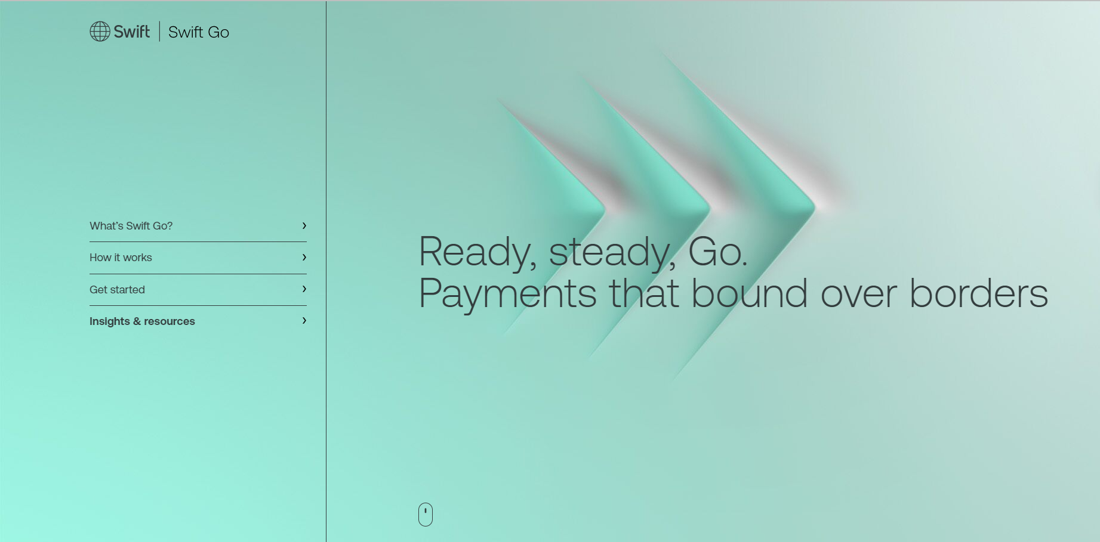
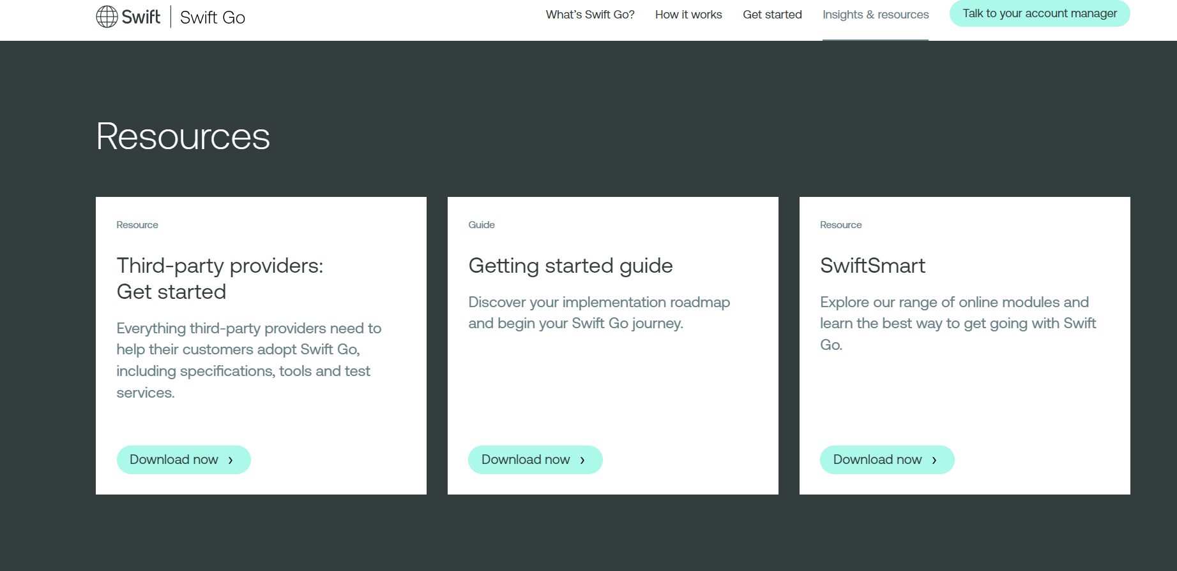
SWIFT Go all in one place
Page on SWIFT.com has been published to provider a single source of all the information, tools,
and resources you need to support SWIFT Go.
What is SWIFT Go?
SWIFT Go for third-party providers

Slide 25







Congratulations! First application providers to self-attest as ‘SWIFT Go ready’
SWIFT Go on SWIFT.com page will be enhanced to list all the application providers that self-attest as ‘SWIFT Go ready’. The page on SWIFT.com will be promoted to banks and financial institutions so they know who they can work with to benefit from SWIFT Go

Slide 26
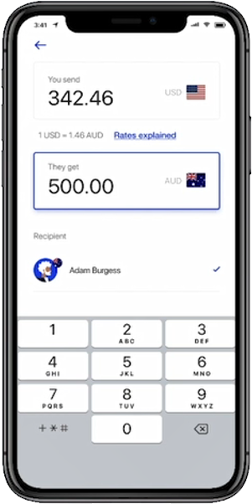
SWIFT Go
Making simple, low-value cross-border payments as easy, predictable, transparent and low cost as domestic payments
Predictable, upfront, end-to-end Amount, time, fees and FX (if applicable) known before payment is sent Status of the payment available to the end customer (through participant bank)
Easy SWIFT Go fees pre-agreed bilaterally between the relevant correspondent banks (simple fee options) Single format Rely on payment pre-validation capabilities and other strategic platform capabilities
Faster Improve current gpi service level on speed Instant where available
Competitive prices Competitive commercial conditions (fees, FX)
SME
Consumer users
This initiative includes a legal stream to ensure compliance with EU competition laws
For illustration purposes only
Notes:
Up to 10k USD/ EUR / GBP

Slide 27
Helping banks improve their servicing for low value payments
Full predictability of payment conditions (time, fees, amount)
Full payment value delivered to end customers through SWIFT Go banks
Reduced processing times, instant where available
Enhanced customer offer
Aim to provide a single format (common currency guide for SWIFT Go banks)
Simplified fee options help banks bilaterally agree, implement and calculate
the commercial conditions for SWIFT Go
Standardisation
Higher STP thanks to a common currency guide and a stricter network validation, also include a roadmap towards full STP
Central Reporting Engine delivered by SWIFT, to help with reconciliation
and bilateral billing between correspondents
Cost reduction

Slide 28
What do application providers need to do to support SWIFT Go?
Providers that support payment initiation:
  Third-party applications that generate/send/receive/process an MT 103 and/or pacs.008 must support the SWIFT Go Single Format; this includes but is not limited to:
      Use of correct service type identifier
      No fees on the message itself (transaction fees are settled outside of payment message)
      Stricter set of validations around fields/elements
      Specifically for payments in USD, EUR, and GBP (this currency list can be extended in the future)
Providers that support beneficiaries and confirmation:
  Third-party applications that generate/send gpi confirmation codes must adhere to the stricter SLA (4hrs)

Slide 29
SWIFT Go: vendor readiness journey (messaging)
Step 1
Step 2
Step 3
Step 4
Step 5
Register with SWIFT by joining the Partner Programme
Download the SWIFT Go rulebook
Access MyStandards Swift Go for third-party providers and develop against the SWIFT Go Single Format specs
Test using SWIFT Go for third-party providers Readiness Portal
Self-attest as
SWIFT Go ‘ready’
Notes:
Required to gain access to Knowledge Centre
Available for all registered partners
Requires MyStandards registration (free)
User-to-application testing of SWIFT Go Single Format compliant MT 103 & 199, pacs.008 & Trck. 001 & 002
List of ‘ready’ Third party providers to be published on SWIFT.com after completing testing and self-attestation declaration
Note: for API based communication vendors can follow the established API readiness journey

Slide 30
Payment Pre-validation

Slide 31




Payment transactions challenges
      REJECTION
Payment instruction
Debtor
Debtor
Agent
Creditor
Agent
Creditor
More than 5% of sent payment instructions fail STP, costing 2B EUR annually - it represents more than 35 million payment transactions per year
A payment not credited on time creates delays and potentially incurs late fees, therefore has negative impact on customer planning and satisfaction
Issues handling, thus reparation costs are often expensive manual processes to run and maintain

Slide 32


Typical reasons of payment frictions
Incorrect account details
Incorrect identifiers and codes
Unknown local market practice
  Quantitative analysis shows 65% of root causes could be addressed with pre-validation.
  The API is designed to support banks and corporates to prepare their cross-border payment requests
  and check, if the payment information is valid and in good standing with the country-specific requirements
  at the destination.

Slide 33



Payment pre-validation: What is it?
Payment
Pre-validation
Payment instruction
Debtor
Debtor
Agent
Creditor
Agent
Creditor
1
LIVE
Beneficiary account verification
Validate payment purpose code
Validate payment purpose
Validate amount
Validate account format
Validate financial institution identifier
Validate category purpose
Collaborative service
Payment Pre-validation
A set of API services which can be called BEFORE sending a payment instruction
Central service
Notes:
These are the currently Live available Payment Pre-validation API services.

Slide 34
Key Payment Pre-validation benefits
Best customer experience
Step by step guidance how to make successful payments
Suggest corrections at the payment phase
Deliver payment faster
Compliance
With international and domestic requirements
Increase certainty before reaching out the beneficiary bank
Reduced operational cost
Automated detection and corrections of payments errors
Fewer payment exceptions and investigations

Slide 35
What do application providers need to do to support Payment Pre-validation?
Application providers who support Payment Pre-validation Consumer API need to:
  Implement an API client and issue API requests towards SWIFT to validate
  cross-border payment information
Application providers who support Payment Pre-validation Data Provider API need to:
  Open an API channel to facilitate the incoming pre-validation requests from SWIFT
  Expose a web server containing the service of validating account and optionally matching names
  Comply with functional specifications (standardised responses)
Additional useful information
Payment Pre-validation webpage
Payment Pre-validation FAQs
Platform Partner programme
How to become a Partner
SWIFTSmart course: Introduction to Payment Pre-validation Services
Please contact SWIFT Support, if you have further questions.

Slide 36



Payment Pre-validation: 3rd party provider readiness journey
Step 1
Step 2
Step 3
Become SWIFT Registered Provider
Join to Platform Partner programme
Implement Preval APIs
and promote
to Production
Cost:
2 500 EUR pa
10 000 EUR pa
Free
Lead time:
c.3 weeks depending on provision of documentation
c.2- 6 weeks depending on 3rd party provider engagement
c.1-2 weeks
depending on 3rd party provider engagement
Mandatory steps to support any APIs
Mandatory step for Payment Pre-validation APIs support

Slide 37
If you have any questions, please contact your Account Manager
or raise a case via the Support page

