Slide 1
SWIFT gpi roadmap and Universal confirmations adoption
Gaurav Sabharwal

Slide 3
The cross-border payments landscape is being reshaped by changing customer expectations, technology, competition and regulation
Customers’ expectations are changing rapidly due to new digital norms mandating immediate access to accurate data
New payment providers are challenging incumbents using technology to disrupt traditional models, putting pressure on costs
Regulation is increasingly protecting end-customers and focusing on market reform, fostering more competition and increased requirements related to liquidity & risk management
Sibos 2019 London

Slide 4
SWIFT gpi has been tackling the challenges in cross-border payments since its inception
Speed
Transparency
Tracking
Remittance information
General Electric
Roche
Viacom
Zoetis
Sibos 2019 London

Slide 5
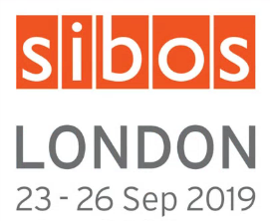
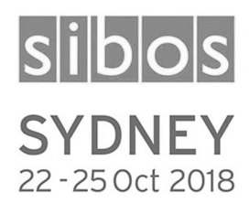
SWIFT gpi traffic has doubled since last Sibos
$300 bn
60+%
1,400+
30%
700
$100 bn
cross-border MT103 sent as gpi
live gpi country corridors
payments value sent as gpi every day
Sibos 2019 London
Notes:
3,629 banks signed
630+ banks live
508 banking groups
(60 of top 60 banking groups)
average, 40% of SWIFT gpi payments are credited to end beneficiaries within 5 minutes, 50% within 30 minutes, 75% within 6 hours, almost 100% within 24 hours

Slide 6
Making gpi FASTER – SWIFT gpi is already very fast
40% within 5 min
50% within 30 min
96% within 24h
Build on the successful pilot with the Australian real-time payment system (NPP), we have launched gpi for instant international payments
Sibos 2019 London

Slide 7
Making SWIFT gpi RICHER – building on the success of the core gpi service
New live gpi services
66+%
SWIFT gpi cover payments
12,000+
gpi stop & recall requests since Jan’19
“We are making cross-border payments as seamless as domestic payments”
gpi for corporates launched
50
participants in gpi for Corporates
25
bank portals have gpi tracking built-in
UBIQUITOUS
SIMPLE
FAST
COST-EFFICIENT
gpi service evolution
Further reduce frictions
Portfolio evolution roadmap

Slide 8
SWIFT gpi roadmap has innovative services aimed at reducing friction and transforming cross-border payment market
Pre-validation
Case resolution
Pay and trace
(live)
(Q1 2020)
(Q2 2020)
Request to pay
(TBD-exploration
ongoing)
gpi link
Financial institution transfer
Instant international payment
(live)
Inbound tracking
(TBD- PoC ongoing)
(Q3 2020)
(v1-Q4 2019
v2 – Q2 2020)

Slide 9
Taking SWIFT gpi BROADER – gpi to become the new norm on SWIFT
2018
2019
2020
Extended tracking on SWIFT
Basic Tracker
Universal Confirmations
UETR on all SWIFT payments
All SWIFT members will benefit from end-to-end tracking
All SWIFT Financial Institutions to confirm MT 103
$
Basic Tracker

Slide 10
Why Universal confirmations?
Payment flow
Payment flow
Payment flow
Confirmation flow
Enhance customer experience
Reduce payment enquiries
Basis for future payment services
Offer Transparency and Payment finality
Prevent frustrating disputes
Support Integrated business processes relying on payment confirmations
proactively status of payment transparency
Reduce inbound enquiries on payment whereabouts
Develop Value added services on top of tracked and confirmed payments
New SWIFT services based on payment confirmations

Slide 11
Business application and connectivity partners are well placed to support the different Universal Confirmations channels
Options to provide confirmations Manual
1 | Basic tracker GUI (*) | Pilot in H2 2019
Payment application
Automatedv
2 | MT 199 Confirm for All | SR 2019
3 | API Confirm for All | SR 2019
4 | ISO 20022 | Q2 2020
5 | Batch confirmations | Pilot in Q2 2020
Certified Interfaces
(*) gpi members use the full SWIFT gpi Tracker GUI for manual confirmations
Service Bureaux

Slide 12
Application providers can benefit by adopting SWIFT gpi services and enabling your customers
Offer innovative and future proof solution
Enhance customer satisfaction and Loyalty
Reuse existing capabilities

Slide 13
SWIFT will support you during every phase of your gpi deployment
Development
Pilot & Testing
Commercialization
Innovation

Slide 14
Business application providers are critical to support SWIFT gpi
15 application vendors confirmed to have a gpi-ready application
SWIFT gpi
Business application
gpi Label Program

Slide 15
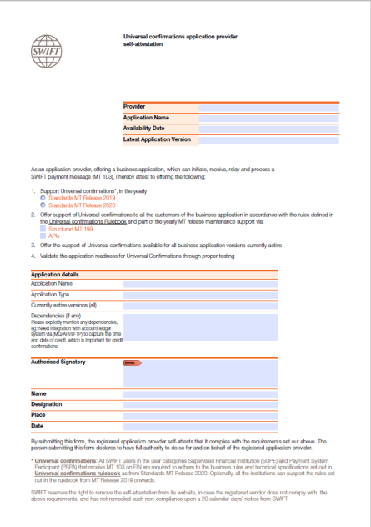
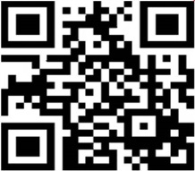
Universal confirmations supporting application providers
Self-Attestation Program
Support Universal confirmation in 2019/2020 Standards MT Release support
Support at least one of the automated channels (MT 199s/APIs)
Support in all business application versions currently active
Validate the application readiness through proper testing (self/with SWIFT)
WHAT ABOUT YOU?

Slide 16
SWIFT invites you to join us and take the next steps to transform cross-border payment space
Additional gpi services (opt –in)
(Instant payments, gpi for corporates, Friction reduction )
Standard gpi services
(gpi Customer Credit Transfer, Cover and Stop& Recall)
Basic Service: Universal confirmations
Standard release 2020
(Mandatory confirmations for all MT 103s)

Slide 17
Capture me to get the presentation and be part of relevant communications
https://www.swift.com/ufap

Slide 18
Join below sessions to learn more on SWIFT gpi
Title | Monday | Tuesday | Wednesday | Thursday
Morning | 10:00 – 10:45 CON: SWIFT gpi – Your guide to the new era of global payments | 09:15 – 10:45 CON: SWIFT gpi revealing the roadmap | 08:45 – 09:15 THEAT: SWIFT gpi payments in the capital markets 10:00 – 10:45 CON: SWIFT gpi -SWIFT gpi - Creating value for corporates | 08:45 – 09:15 THEAT: SWIFT gpi cross-border payments collection – a dream come true for every global corporate 09:15 – 09:45 KNOW: Simplifying your SWIFT gpi onboarding journey 10:00 – 10:45 CON: Delivering a customer-first payments experience
Lunch-time | 13:00 – 13:45 CON: What will the world look like when all payments are confirmed? Get ready for 2020 13:00 – 13:30: THEAT: gpi Observer Analytics solution: a must-have for your organisation | 13:15 – 13: 45: THEAT: SWIFT gpi pre-validation: Letting payments fly | 12:15 – 12:45 THEAT: SWIFT gpi meets ISO 20022: Reducing friction further 12:15 - 13:00 MAIN: Ecosystems are blooming – What does it mean for payments?
Afternoon | 13:45 – 14:15: KNOW: Unparalleled actionable insights to optimise your gpi payments with gpi Observer Analytics 14:00- 14:30 THEAT: Basic Tracker: Unlocking payment confirmations for all 14:45 – 15:15 KNOW: Top tips for a smooth gpi onboarding 15:15 – 16:00 MAIN: Pulp friction – where are we on the roads towards frictionless payments? 16:15 – 16:45 THEAT: SWIFT gpi instant payments making instant cross-border payments a reality | 14:00 – 14:30 THEAT: SWIFT gpi case resolution: exceptions and investigations made simple 14:45 – 15:15 KNOW: Integrating gpi tracking into your customer portal 15:15 – 16:00 MAIN: Banks and instant payments – where is the sweet spot? 16:30 – 17:00 KNOW: Getting ready for the mandatory payment credit confirmations | 13:15 – 13:45 THEAT: SWIFT gpi inbound tracking: Serving supplier needs 14:00 – 14:45 CON: SWIFT gpi – looking into the future 15:45 – 16:15 THEAT: SWIFT gpi link: Linking SWIFT gpi with trade platforms – the results 16:30 – 17:00 KNOW: SWIFT gpi pay and trace: Multi-bank tracking embedded in corporate treasury dashboards

Slide 19
Pass by the SWIFT stand for a demo on the Basic Tracker

Slide 20
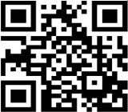
www.swift.com/confirm

Slide 21
?
Questions

